Slide 1

SWITCH RECOGNITION AND DETECTION

Slide 2
INTRODUCTION

Slide 3
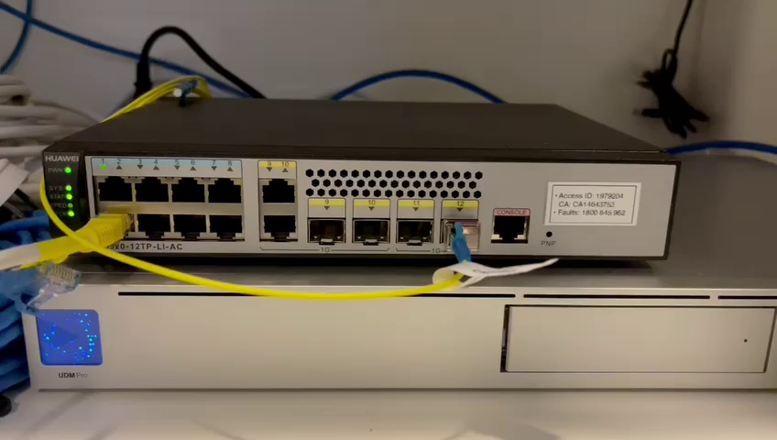
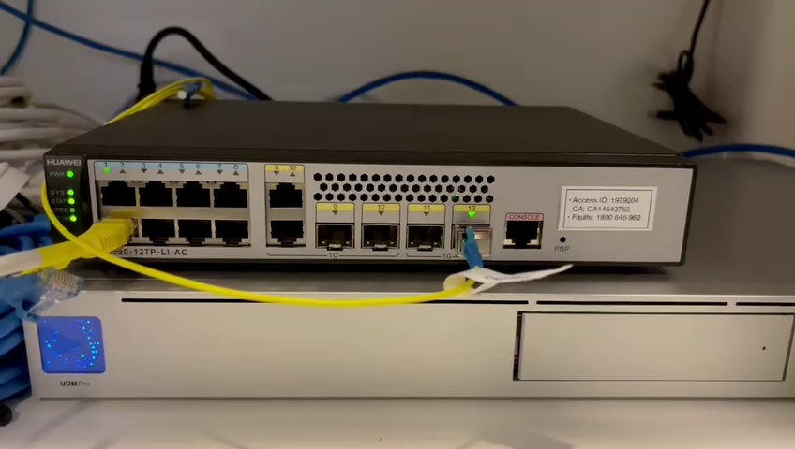

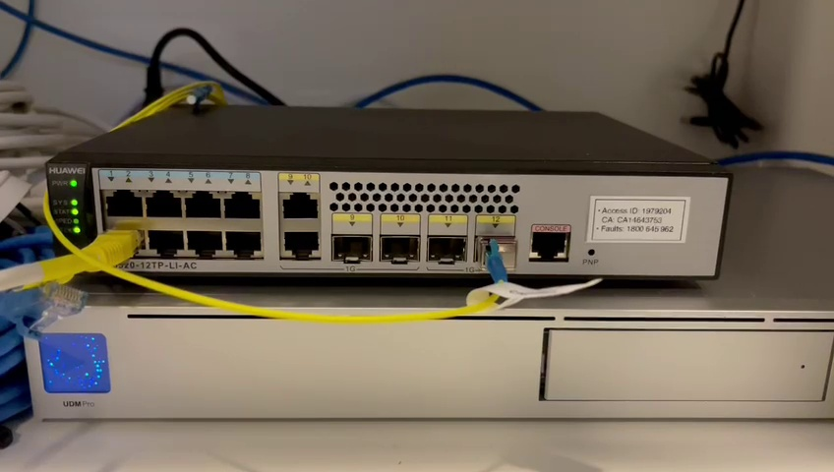
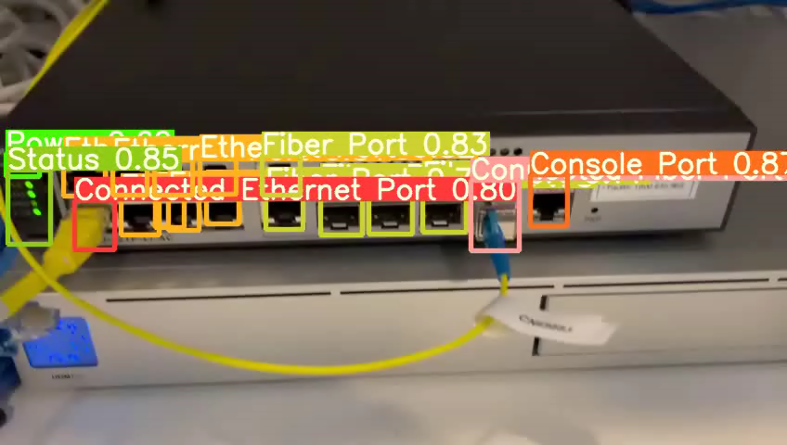
Switch detection and recognition
Detects ports available on a switch
Detect connected cables to a switch
Detect and extract the switch information
Accuracy upto 85%
Using YOLOv5, trained on 90 odd images, 3000 epochs.
Testing produces results with ports and wires marked with the percentage of confidence in detection.
7 classes: ['Connected Ethernet Port', 'Connected Fiber Port', 'Console Port', 'Ethernet Port', 'Fiber Port', 'Power', 'Status']

Slide 4
Can be expanded to detect various kind of switches and accommodate different connection patterns.
Right now trained on just one type of switch
Can detect various types of connections.
Model is trained on augmented images to recognise the bounding box around the identified object.
Learns using anchor boxes.

